Slide 1
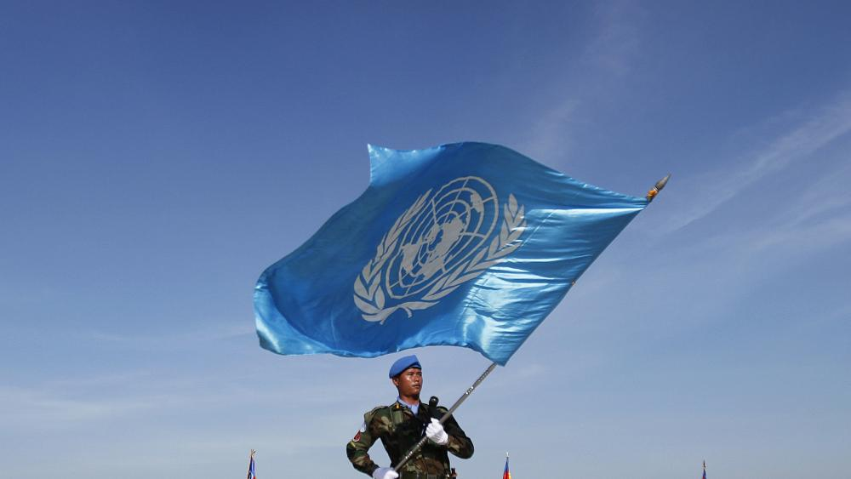
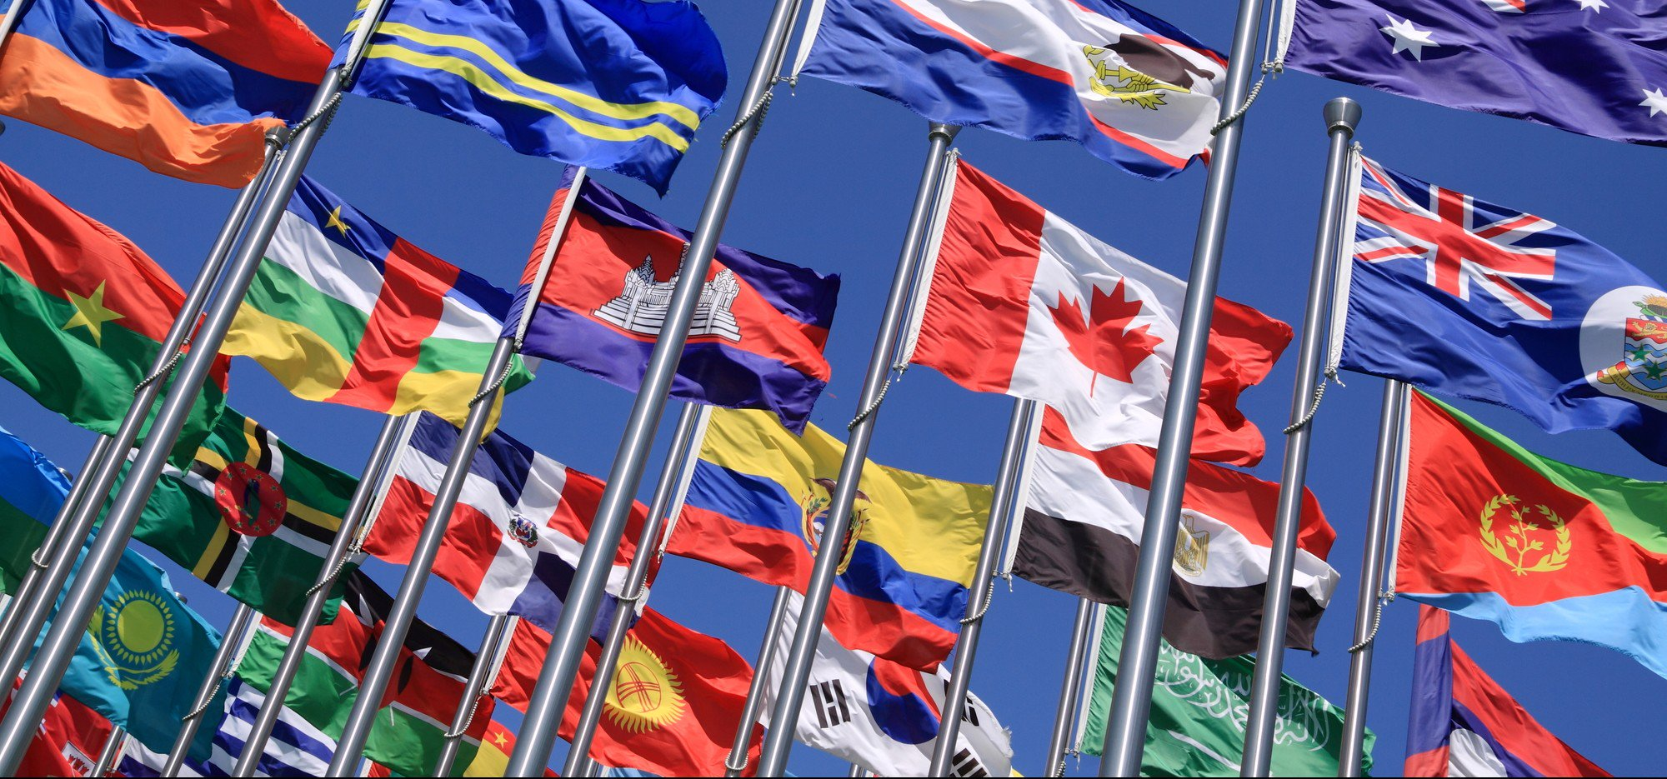
“The U.N. is like your conscience. It can’t make you do the right thing, but it can help you make the right decision.”

Slide 2
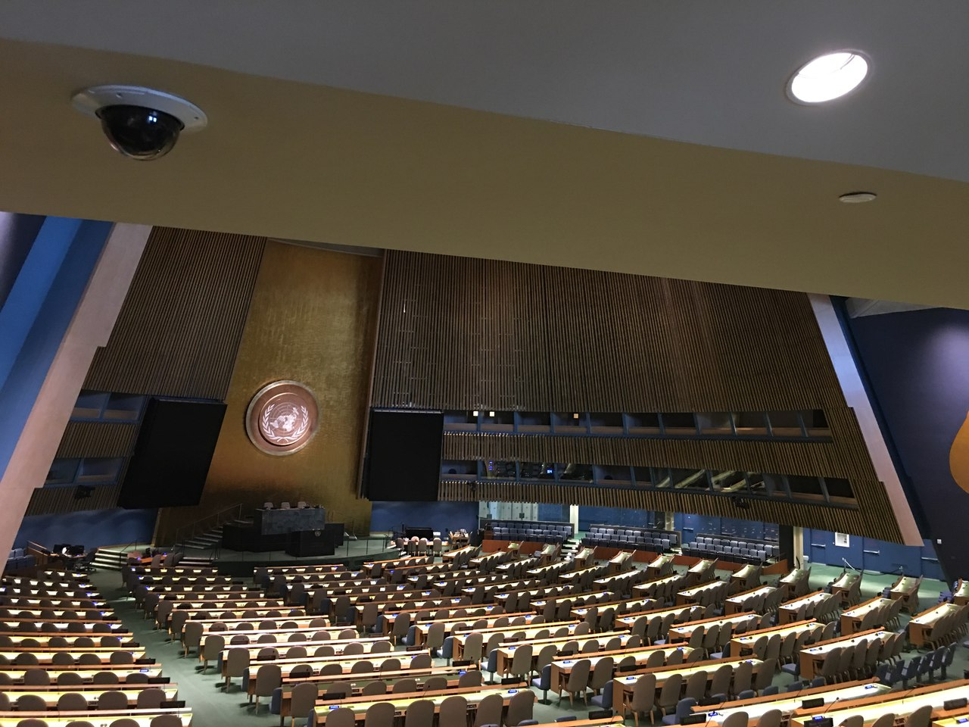
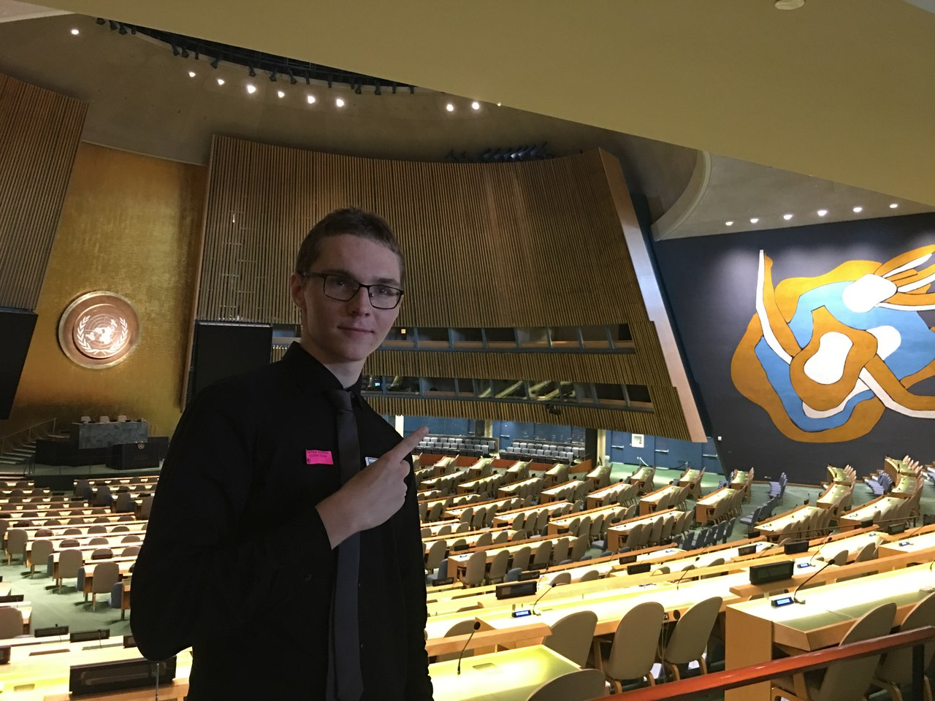
GENERAL ASSEMBLY
The opening of the U.N.
General Assembly “is
the World Cup of
diplomacy, it’s the Oscars
of diplomacy. It’s also an
interesting fashion week.”
The Assembly meets in regular session intensively from September to December each year, and then as required.
What they do is
1) Consider and make recommendations;
2) Discuss any question relating to international peace and security and, except where a dispute or situation is currently being discussed by the Security Council, make recommendations on it;
3) Discuss, with the same exception, and make recommendations on any questions within the scope of the Charter or affecting the powers and functions of any organ of the United Nations;
4) Make recommendations for the peaceful settlement of any situation that might impair friendly relations among nations;
5) Consider and approve the United Nations budget and establish the financial assessments of Member States;
6) Elect the non-permanent members of the Security Council and the members of other United Nations councils and organs and, on the recommendation of the Security Council, appoint the Secretary-General.

Slide 3
THE PROBLEMS
One state-one vote system allows only 5% of world’s population to pass a 2/3 majority resolution
Resolutions do not have the binding forces over the member nations
Cannot enforce its decisions
The "Uniting for Peace" resolution empowered the Assembly to convene in emergency special session in order to recommend collective measures, including the use of armed force, in the event of a breach of the peace or an act of aggression.
Emergency special sessions have been convened under this procedure on ten occasions. The two most recent, in 1982 and 1997–2009, were about the status of the territories occupied by the State of Israel.

Slide 4
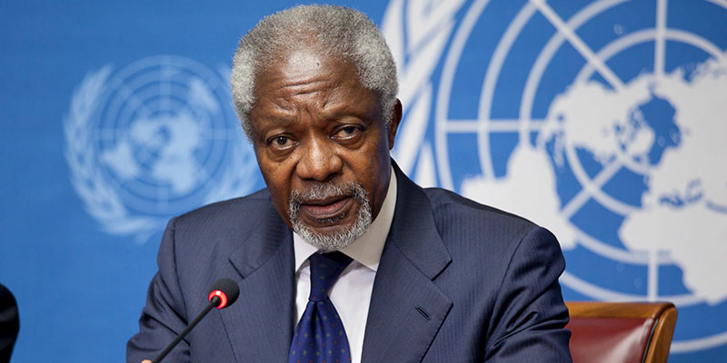
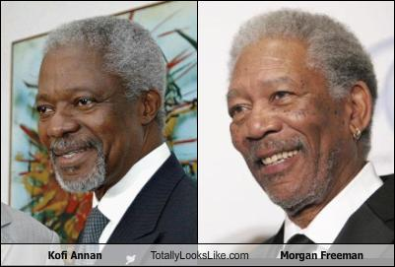
REFORM
On 21 March 2005, Secretary-General Kofi Annan presented a reportthat criticized the General Assembly for focusing so much on consensus that it was passing resolutions reflecting "the lowest common denominator of widely different opinions”.
He also criticized the Assembly for too broad agenda
Annan recommended
1)reviewing the General Assembly's agenda, committee structure, and procedures;
2) strengthening the role and authority of its president; and
3) establishing a mechanism to review the decisions of its
Annan reminded UN members of their responsibility to implement reforms, if they expect to realize improvements in UN effectiveness.

Slide 5
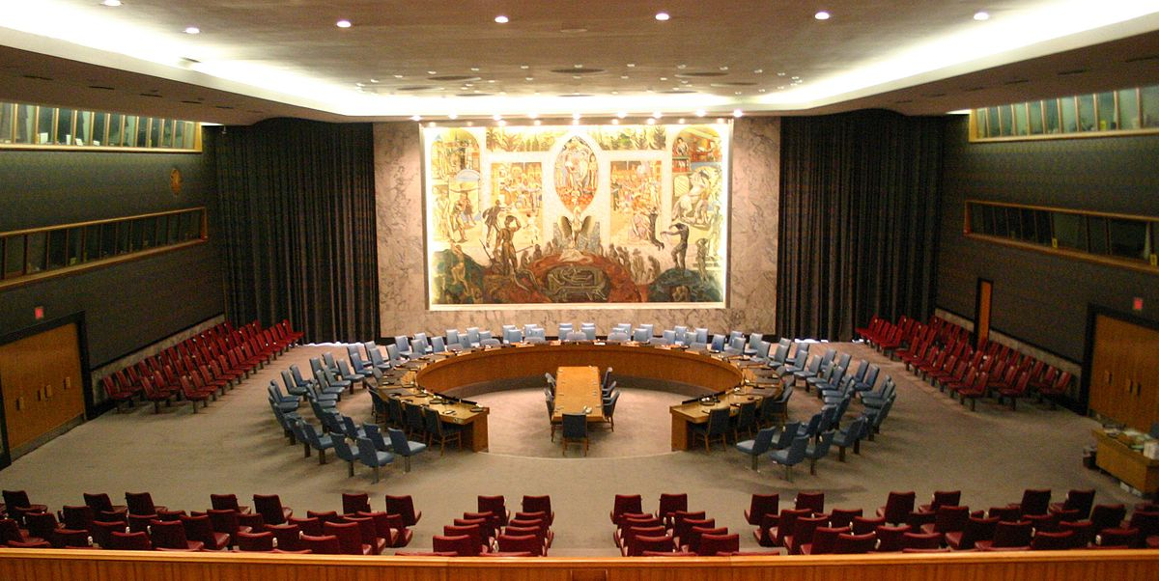
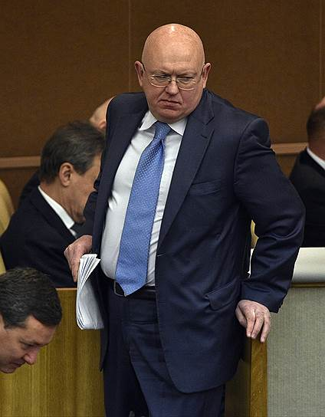
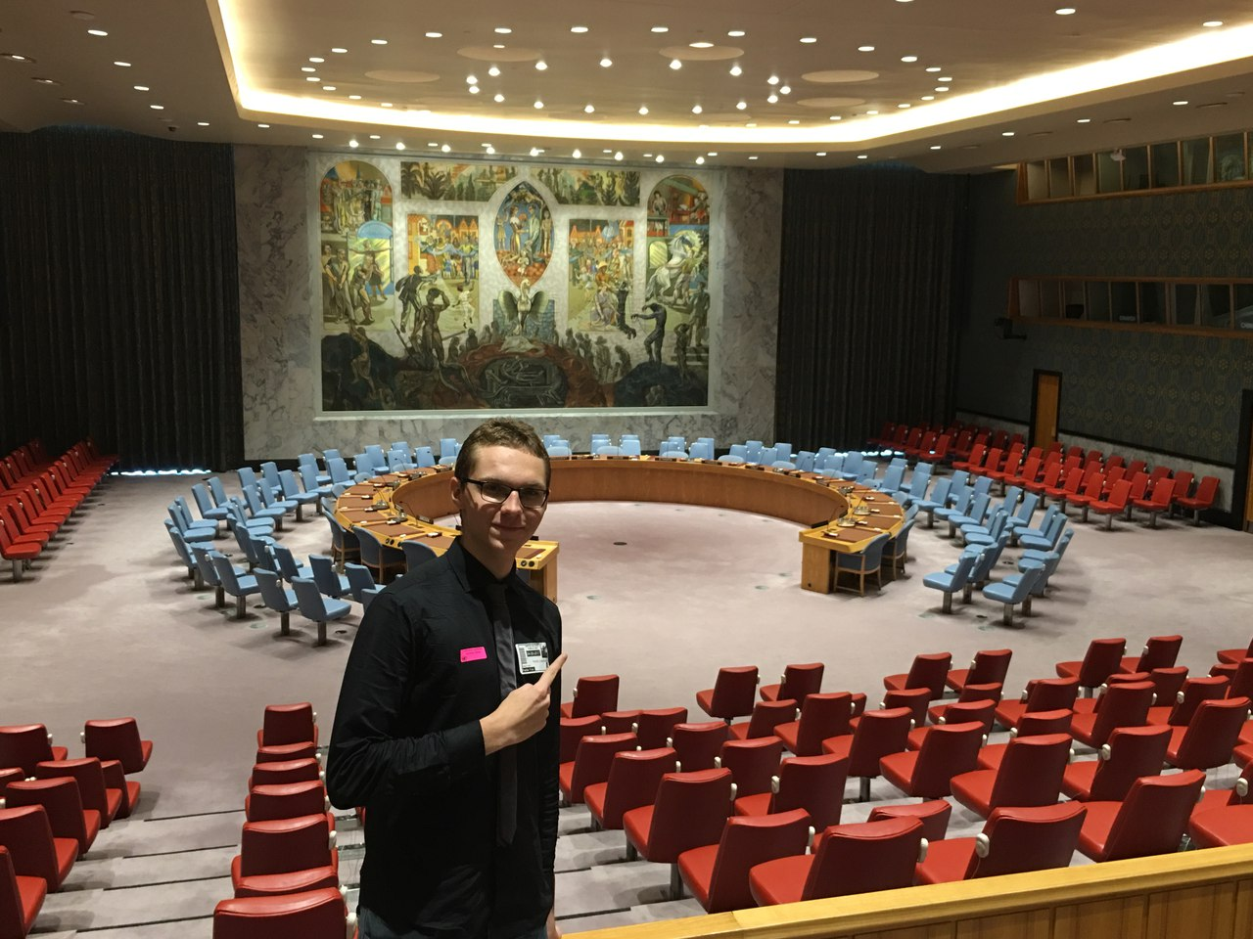
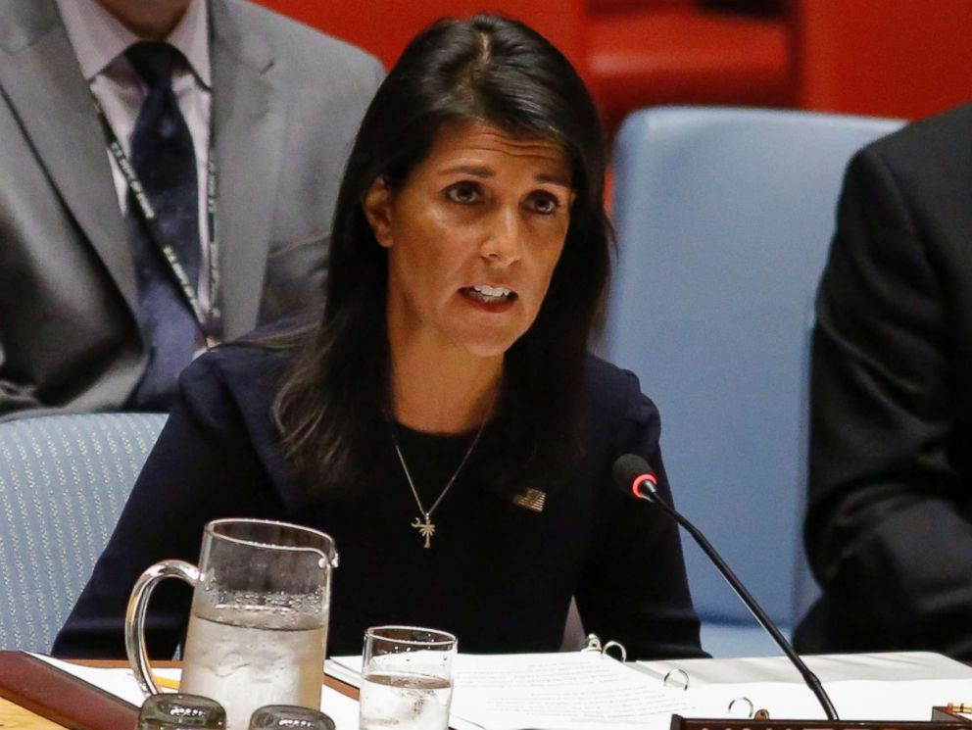
SECURITY COUNCIL
Decisions are legally binding
The only UN body that can authorize military operations
G5 states have veto power

Slide 6
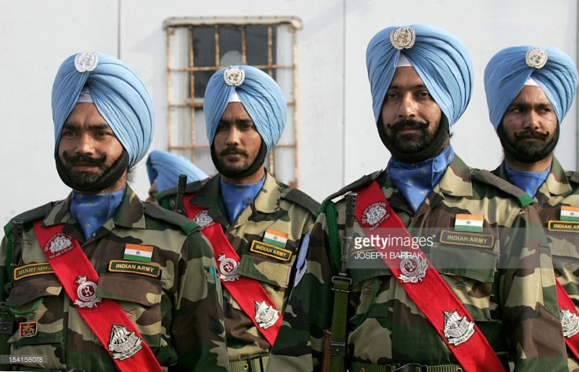
PEACe-KEEPING OPERATIONS
Authorized only by SC
Started being conducted on large scale only after the end of the Cold War
Governed by DPKO-Department of Peace-Keeping operations
Can start even if the opponents have not reached cease-fire agreement
All countries sponsor peace-keeping missions using the formula they determine themselves, but the debt is still about 3 billion dollars
Are not only about military help

Slide 7
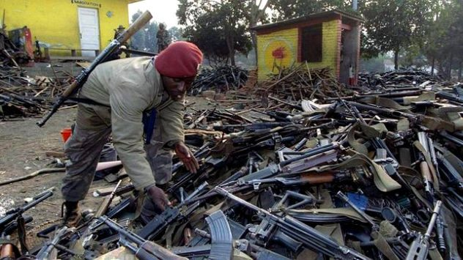
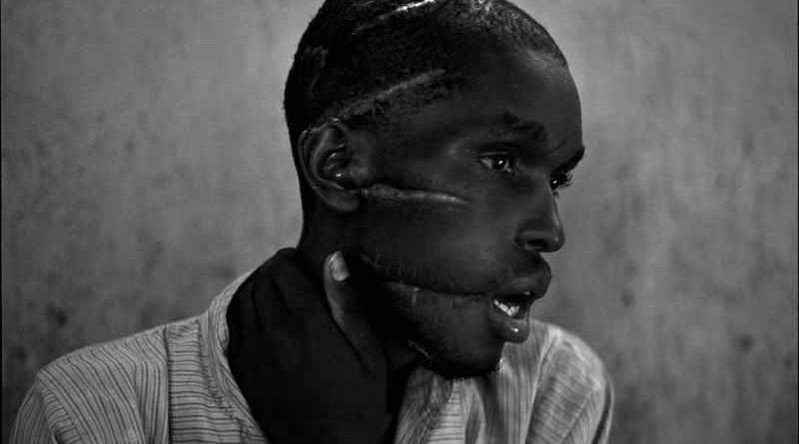
Rwanda genocide
From April to July 1994, members of the Hutu ethnic majority in the east-central African nation of Rwanda murdered 800,000 people, mostly of the Tutsi minority.
Begun by extreme Hutu nationalists in the capital of Kigali, the genocide spread throughout the country with speed and brutality, as ordinary citizens were incited by local officials and the Hutu Power government to take up arms against their neighbors.
The USA, Belgium and the UN were critisized for complacency and lack of action

Slide 8
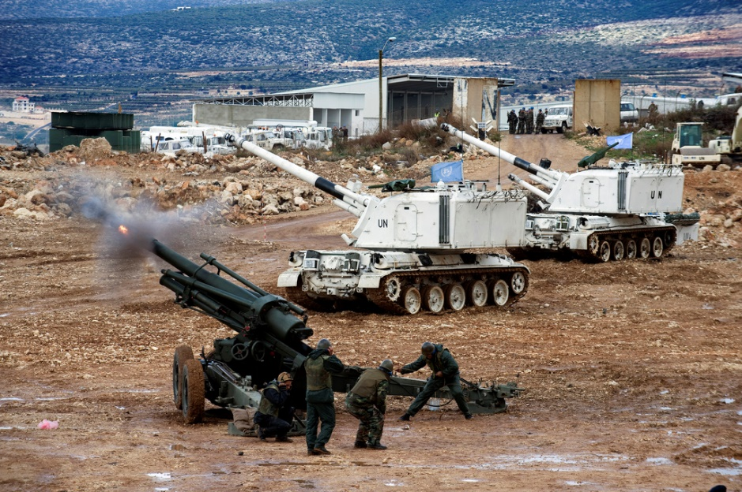
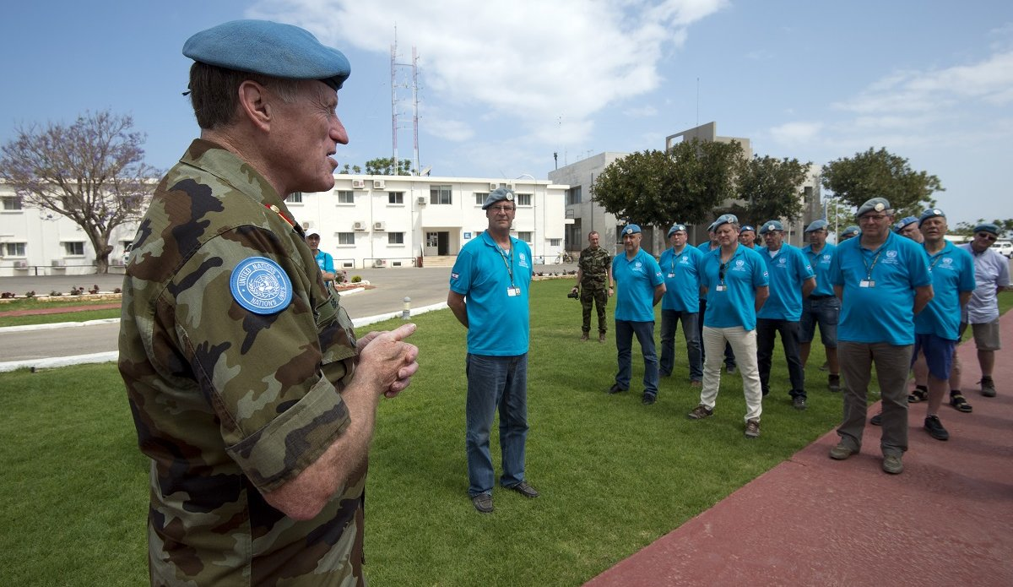
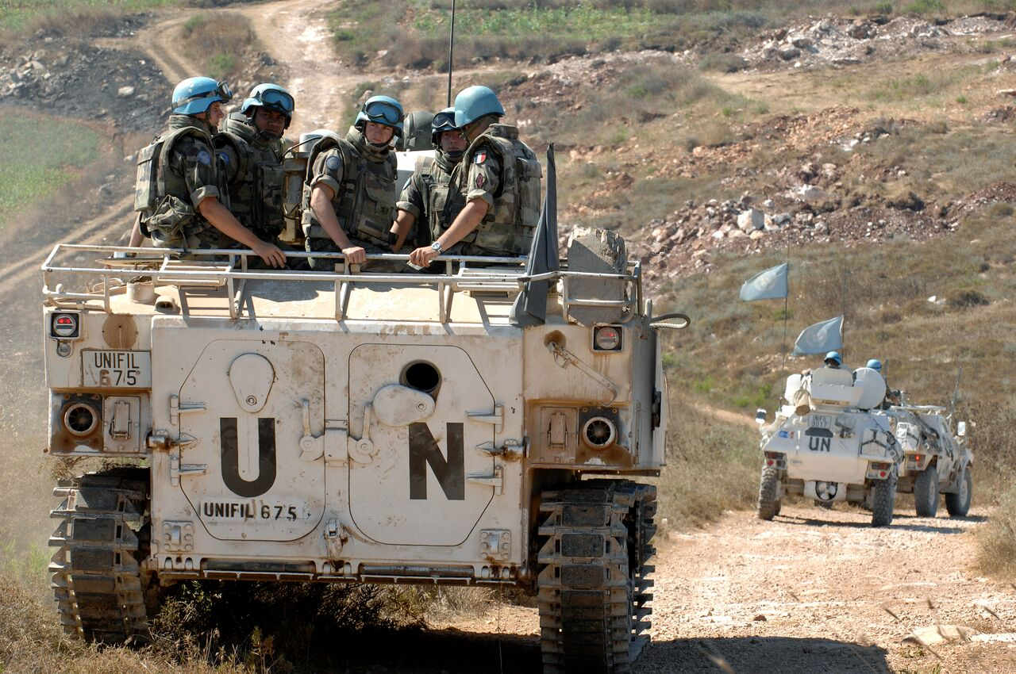
UNIFIL
Apart from preventing the breach of peace, UNIFIL organizes blood donation, educate children and orphans, demine territories contaminated with landmines
1) Was established in 1978
2) Was numerously accused of being ineffective
3) 10 838 soldiers
4) The main goal is to prevent Hezbolla from crossing the border with Israel and prevent attacks
5) Isreal claims that UNFIL assists Hezbolla

Slide 9
70% of finacial recources of the UN go to this forum
As most committees, can only recommned sanctions
Decisions are not legally binding
Has launched a number of initiatives for LEDCs
Has created a number of subsidiary bodies, some of whih are currently independent
Commission on
Narcotic Drugs
The Human rights
committee
UNAIDS

Slide 10
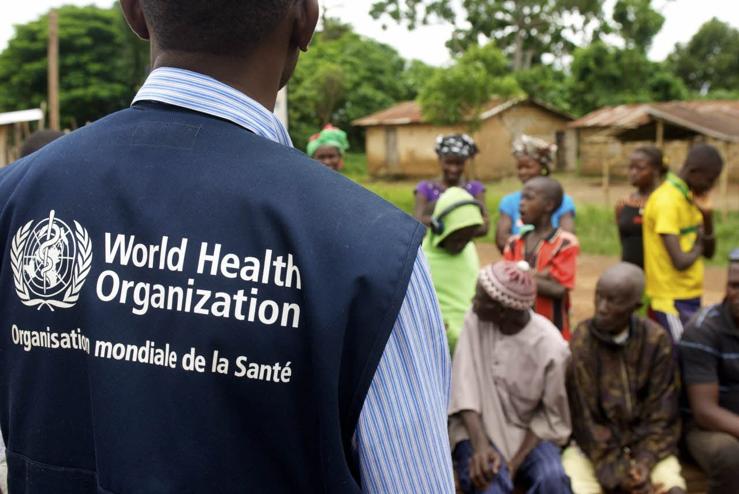
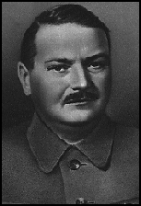
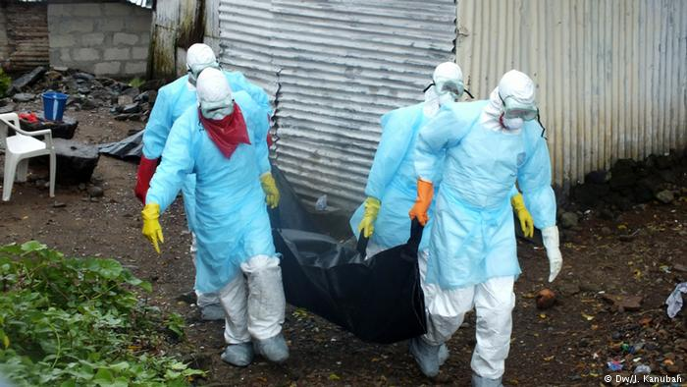
Have defeated smallpox in 1958-1979
Since 1986 have a special committee devoted to HIV / AIDS
Played a crucial role in the 2014-295 Ebola outbreak
Have helped to decrease the polio spread for 90%

Slide 11
НА КАКОЙ ОСНОВЕ ФОРМИРУЕТСЯ ВОЕННЫЙ КОНТИНГЕНТ ООН?
2) КАКИЕ РЕШЕНИЯ ГА ОБЯЗАТЕЛЬНЫ ДЛЯ ВСЕХ СТРАН?
3) КАКОЙ ГЕНСЕК ПРЕДЛАГАЛ В 2005 РЕФОРМУ ООН?
4) А ОНА СОСТОЯЛАСЬ?
5) КАКОЙ ОРГАН ООН МОЖЕТ ВВОДИТЬ САНКЦИИ?
6) КАКИЕ ВОПРОСЫ НЕ МОЖЕТ ОБСУЖДАТЬ ГА?
7) В КАКИХ СЛУЧАЯХ ГА ВСЕ-ТАКИ ЭТО ОБСУЖДАЕТ?
8) КОГДА У ВАС ЗАЧЕТ ПО COUNTRY PROFILE?

Slide 12
THANK YOU FOR YOUR ATTENTION

